Slide 1

IN432
Advanced Web Programming

Slide 2
Lecture Outline:
Explaining the course syllabus
History of Internet and World Wide Web
  World Wide Web Consortium (W3C)
Computer Languages
  Difference between interpreter and compiler.
Difference between client-side and server-side programming
Static and dynamic websites
HTML Versions

Slide 3
Explaining the course syllabus.
Course Objectives and Learning Outcomes
Grading Policy

Slide 4
History of the Internet and World Wide Web
In late 1960s’ ARPANET (Advanced Research Project Agency of Department of Defense)
Networking → sending emails
Transmission Control Protocol (TCP)
Internet Protocol (IP)
Evolved into today’s Internet
In 1989 World Wide Web → sharing hyperlinked documents
Hypertext Transfer Protocol (HTTP)
In 1993, Mosaic browser (Netscape)

Slide 5
World Wide Web Consortium (W3C)
1994, organization to develop non-proprietary technology
Make the web universally accessible
Standardization

Slide 6
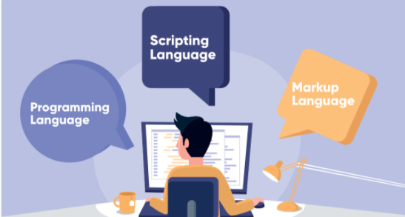
Difference between markup languages, scripting languages and programming languages.
When it comes to making a website or app coding involves basically three types of languages:
The programming language
Scripting Language
Markup Language.

Slide 7
Difference between markup languages, scripting languages and programming languages.
The programming language : In simple terms, programming languages are set of instructions or code which tells a computer what it needs to do.(C++,C , Java, C# … )
Scripting Language: Scripting languages are basically the subcategory of programming languages which is used to give guidance to another program or we can say to control another program, so it also involves instructions. (Java Script , PHP,Python..) Scripting languages are most widely used to create a website.
Markup Language: These are presentational languages and it doesn’t include any kind of logic or algorithm, Examples of Markup languages are HTML, CSS or XML. These languages are most widely used to design a website.

Slide 8
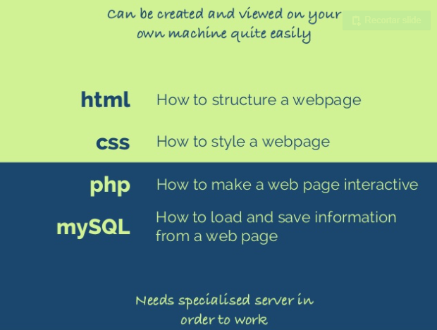
What is and why to use HTML, CSS, PHP & MYSQL

Slide 9
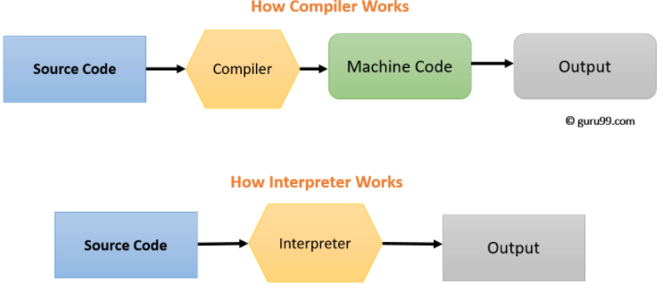
Difference between interpreter and compiler.

Slide 10
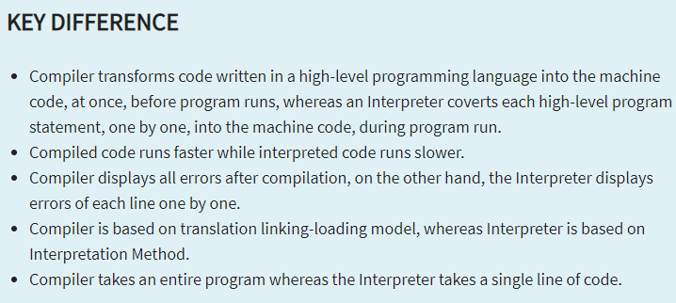
Difference between interpreter and compiler.

Slide 11
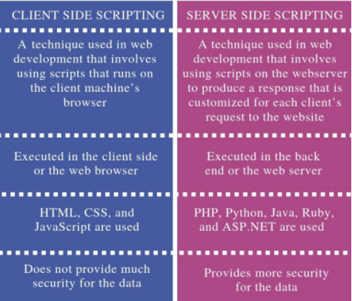
Difference between client-side and server-side programming.
The main difference between client side scripting and server side scripting is that the
client side scripting is used to write scripts that are executed in the client side or browser
while
the server side scripting is used to write scripts that are executed in the server side or the server.

Slide 12
Web Essentials
Client: web browsers, used to surf the Web
Server systems: used to supply information to these browsers
Computer networks: used to support the browser-server communication
Request “document A”
document A
Client
Server

Slide 13
Internet v.s. Web
The Internet: a inter-connected computer networks, linked by wires, cables, wireless connections, etc.
Web: a collection of interconnected documents and other resources.
The world wide web (WWW) is accessible via the Internet, as are many other services including email, file sharing, etc.

Slide 14
The World Wide Web (WWW)
WWW is a system of interlinked, hypertext documents that runs over the Internet
Two types of software:
  Client: a system that wishes to access the information provided by servers must run client software (e.g., web browser)
  Server: an internet-connected computer that wishes to provide information to others must run server software
  Client and server applications communicate over the Internet by following a protocol built on top of TCP/IP – HyperText Transport Protocol (HTTP)

Slide 15
Basics of the WWW
Hypertext: a format of information which allows one to move from one part of a document to another or from one document to another through hyperlinks
Uniform Resource Locator (URL): unique identifiers used to locate a particular resource on the network
Markup language: defines the structure and content of hypertext documents

Slide 16
Web Client: Browser
Makes HTTP requests on behalf of the user
  Reformat the URL entered as a valid HTTP request
  Use DNS to convert server’s host name to appropriate IP address
  Establish a TCP connection using the IP address
  Send HTTP request over the connection and wait for server’s response
  Display the document contained in the response
    If the document is not a plain-text document but instead is written in HTML, this involves rendering the document (positioning text, graphics, creating table borders, using appropriate fonts, etc.)

Slide 17
Web Servers
Main functionalities:
  Server waits for connect requests
  When a connection request is received, the server creates a new process to handle this connection
  The new process establishes the TCP connection and waits for HTTP requests
  The new process invokes software that maps the requested URL to a resource on the server
  If the resource is a file, creates an HTTP response that contains the file in the body of the response message
  If the resource is a program, runs the program, and returns the output

Slide 18
Static Web: HTML/XHTML, CSS
HTML stands for HyperText Markup Language
  It is a text file containing small markup tags that tell the Web browser how to display the page
XHTML stands for eXtensible HyperText Markup Language
  It is identical to HTML 4.01
  It is a stricter and cleaner version of HTML
CSS stands for Cascading Style Sheets
  It defines how to display HTML elements

Slide 19
Why Programmability?
What’s the drawback to simple document model?
  Static
  Assume that documents are created before they are requested
What are examples of information that might be part of web documents that may not be known before they are requested?

Slide 20
Client-Side Programmability
Scripting language: a lightweight programming language
Browser scripting: JavaScript
  Designed to add interactivity to HTML pages
  Usually embedded into HTML pages
  What can a JavaScript Do?
    Put dynamic text into an HTML page
    React to events
    Read and write HTML elements
    Validate data before it is submitted to a server
    Create cookies
    …

Slide 21
Server-Side Programmability
The requests cause the response to be generated
Server scripting:
  CGI/Perl: Common Gate Way Interface (*.pl, *.cgi)
  PHP: Open source, strong database support (*.php)
  ASP: Microsoft product, uses .Net framework (*.aspx)
  Java via JavaServer Pages (*.jsp)
  …

Slide 22
HTML Versions
HTML 1.0 | HTML 2.0 | HTML 3.0
Early 190s Few web developers Limited language | 1995 – 1997 Included everything from the original version Added few features | Netscape added new tags & attributes to their browser HTML group introduced Version dropped because other browsers needed a lot of work and time to implement the new features
HTML 3.2 | HTML 4.01 | HTML 5
January 1997 Need for a standard W3C → HTML 3.2 standardized version | December 1997 Official documentation Cascading Style Sheets (CSS) | October 2014 W3C working on XHTML 2.0 Web Hypertext Application Technology Working Group (WHATWG) → HTML 5 New features Document structure Canvas – draw graphics Multimedia

